Slide 1
Subgradient Descent: Some Examples + Large-Margin Classification (SVM)
CS771: Introduction to Machine Learning
Piyush Rai

Slide 2
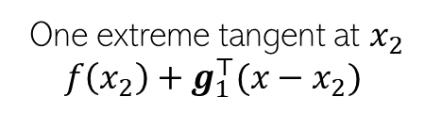


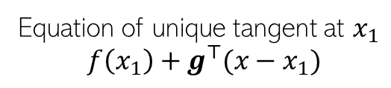


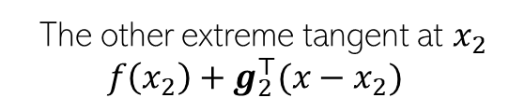
Sub-gradients
For convex non-diff fn, can define sub-gradients at point(s) of non-differentiabilty
For a convex, non-diff function $f(x)$, sub-gradient at$x_{∗}$is any vector $g$ s.t. $∀x$
$$f\left(x\right)$$
Convex, thus lies above all its tangents
Equation of unique tangent at $x_{1}$
$$f\left(x_{1}\right)+g^{⊤}(x−x_{1})$$
differentiable
here
One extreme tangent at $x_{2}$
$$f\left(x_{2}\right)+g_{1}^{⊤}(x−x_{2})$$
non-differentiable
here
Region containing all sub-gradients
The other extreme tangent at $x_{2}$
$$f\left(x_{2}\right)+g_{2}^{⊤}(x−x_{2})$$
$$x_{1}$$
$$x_{2}$$
$$f\left(x\right)≥f\left(x_{∗}\right)+ g^{⊤}(x−x_{∗})$$

Slide 3
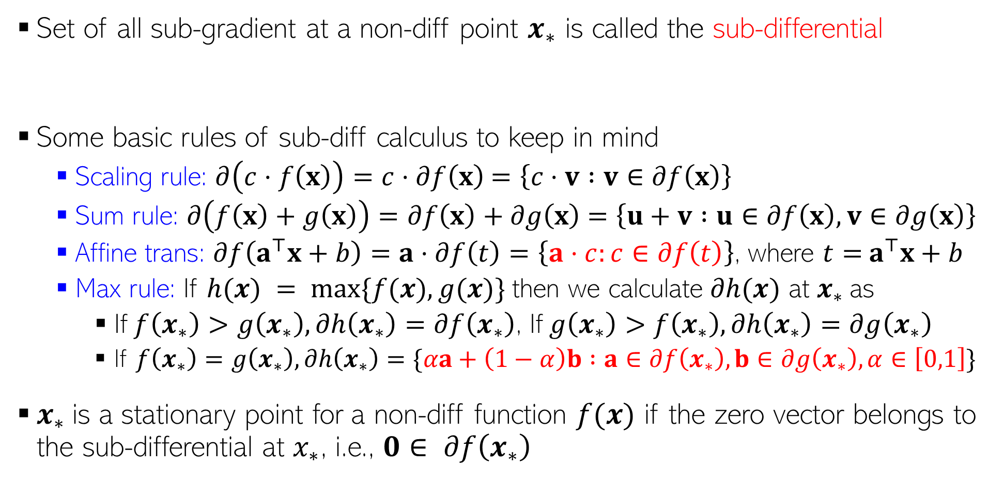
Sub-gradients, Sub-differential, and Some Rules
Set of all sub-gradient at a non-diff point $x_{∗}$ is called the sub-differential
Some basic rules of sub-diff calculus to keep in mind
Scaling rule: $∂\left(c⋅f\left(x\right)\right)=c⋅∂f\left(x\right)$ $=\left\{c⋅v :v∈∂f\left(x\right)\right\}$
Sum rule: $∂\left(f\left(x\right)+g\left(x\right)\right)=∂f\left(x\right)+∂g\left(x\right)$ $=\left\{u+v :u∈∂f\left(x\right),v∈∂g\left(x\right)\right\}$
Affine trans: $∂f\left(a^{⊤}x+b\right)=a⋅∂f\left(t\right)=\left\{a⋅c:c∈∂f\left(t\right)\right\}$, where $t=$ $a^{⊤}x+b$
Max rule: If $h(x) = max⁡\{f(x),g(x)\}$then we calculate $∂h(x)$ at $x_{∗}$as
If $f\left(x_{∗}\right)>g\left(x_{∗}\right),∂h\left(x_{∗}\right)=∂f\left(x_{∗}\right)$, If $g\left(x_{∗}\right)>f\left(x_{∗}\right),∂h\left(x_{∗}\right)=∂g\left(x_{∗}\right)$
If $f\left(x_{∗}\right)=g\left(x_{∗}\right), ∂h\left(x_{∗}\right)=\{αa+\left(1−α\right)b :a∈∂f\left(x_{∗}\right),b∈∂g\left(x_{∗}\right),α∈\left[0,1\right]\}$
$x_{∗}$is a stationary point for a non-diff function $f(x)$ if the zero vector belongs to the sub-differential at $x_{∗}$, i.e., $0∈ ∂f\left(x_{∗}\right)$
$$∂f\left(x_{∗}\right)≜\left\{g :f\left(x\right)≥{f\left(x_{∗}\right)+g}^{⊤}\left(x−x_{∗}\right) ∀x\right\}$$
The affine transform rule is a special case of the more general chain rule

Slide 4


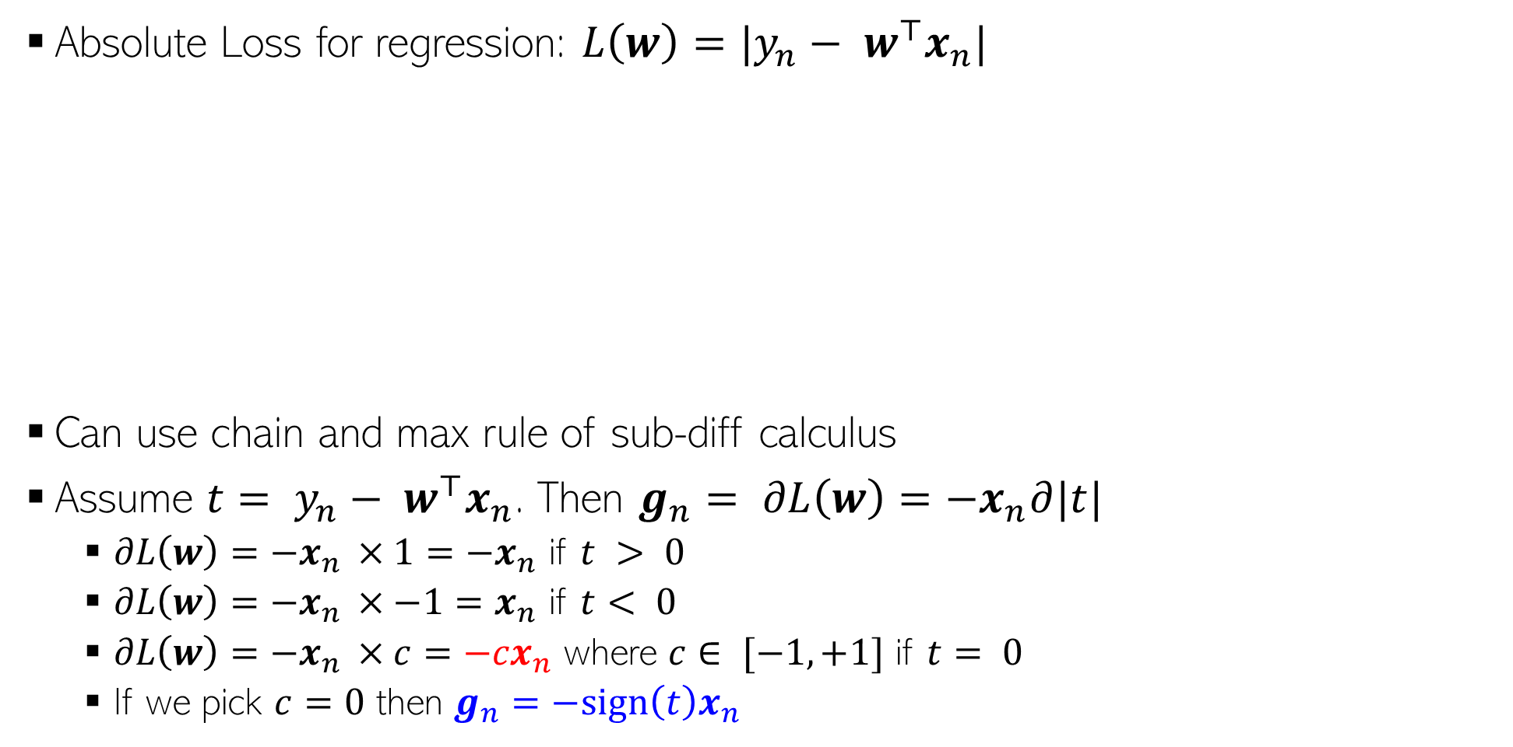

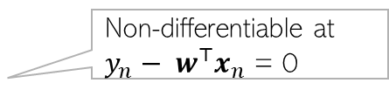

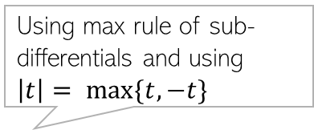

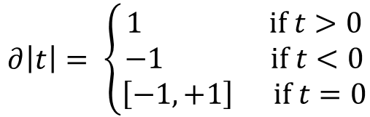


Subgradient For Regression with Absolute Loss
Absolute Loss for regression: $L\left(w\right)=|y_{n}− w^{⊤}x_{n}|$
Can use chain and max rule of sub-diff calculus
Assume ${t= y}_{n}− w^{⊤}x_{n}$. Then $g_{n}= ∂L\left(w\right)=−x_{n}∂|t|$
$∂L\left(w\right)=−x_{n }×1=−x_{n}$ if $t > 0$
$∂L\left(w\right)=−x_{n }×−1=x_{n}$ if $t< 0$
$∂L\left(w\right)=−x_{n }×c=−{cx}_{n}$ where $c∈ [−1,+1]$ if $t= 0$
If we pick $c=0$ then $g_{n}=−sign\left(t\right)x_{n}$
Using max rule of sub-differentials and using $\left|t\right|= max\{t,−t\}$
$$|y_{n}− w^{⊤}x_{n}|$$
$$|t|$$
$∂\left|t\right|= \left\{\begin{aligned}1 if t>0 \\ −1 if t<0 \\ \left[−1,+1\right] if t=0\end{aligned}\right.$
Non-differentiable at $y_{n}− w^{⊤}x_{n}$ = 0
$$0$$
$$y_{n}− w^{⊤}x_{n}$$
$$0$$
$$t$$
Can now use subgradient descent or stochastic subgradient descent using these (sub)gradients

Slide 5
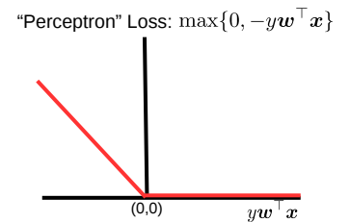



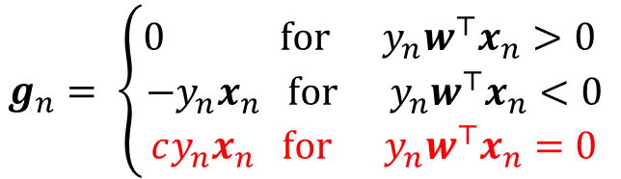
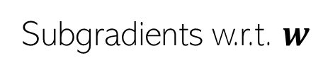
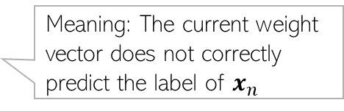

Subgradient for Classification with Perceptron Loss
Perceptron loss for binary classification: $L\left(w\right)= \sum_{n=1}^{N}{max\{0,−y_{n}w^{⊤}x_{n}\}}$
If we pick $c =−1$then $g_{n}=−𝕀\left[y_{n}w^{⊤}x_{n}≤0\right]y_{n}x_{n}$
Stochastic subgradient descent for Perceptron loss will have updates of the form
Subgradients w.r.t. $w$
Using max rule of sub-differentials
$$g_{n}= \left\{\begin{aligned}0 for y_{n}w^{⊤}x_{n}>0 \\ −y_{n}x_{n} for y_{n}w^{⊤}x_{n}<0 \\ cy_{n}x_{n} for y_{n}w^{⊤}x_{n}=0 \end{aligned}\right.$$
$$\text{(}\text{where} \text{c} ∈[−1,0])$$
$$if y_{n}{w^{(t)}}^{⊤}x_{n}≤0$$
Meaning: The current weight vector does not correctly predict the label of $x_{n}$
“mistake-driven” update (update only when the current weights make a mistake)
$$w^{(t+1)}= w^{(t)}+{η_{t}y}_{n}x_{n}$$

Slide 6

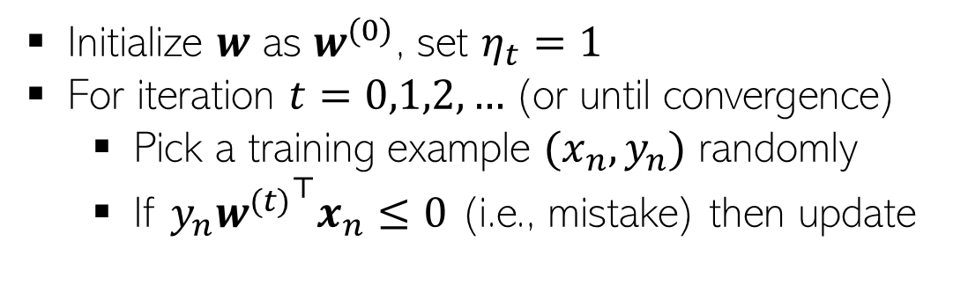

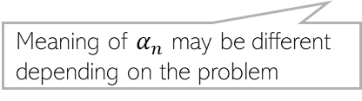
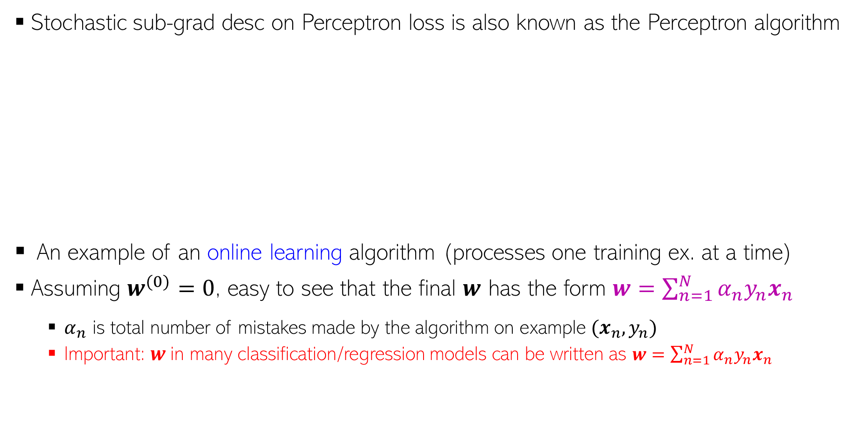
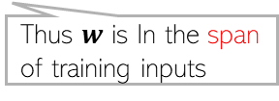
Perceptron Algorithm for Binary Classification
Stochastic sub-grad desc on Perceptron loss is also known as the Perceptron algorithm
An example of an online learning algorithm (processes one training ex. at a time)
Assuming $w^{(0)}=0$, easy to see that the final $w$ has the form $w=\sum_{n=1}^{N}{α_{n}y_{n}x_{n}}$
$α_{n}$ is total number of mistakes made by the algorithm on example $(x_{n}, y_{n})$
Important: $w$in many classification/regression models can be written as $w=\sum_{n=1}^{N}{α_{n}y_{n}x_{n}}$
Initialize $w$ as $w^{(0)}$, set $η_{t}=1$
For iteration $t=0,1,2,…$(or until convergence)
Pick a training example $(x_{n}, y_{n})$ randomly
If $y_{n}{w^{(t)}}^{⊤}x_{n}≤0$ (i.e., mistake) then update
Updates are “corrective”: If $y_{n}= +1$ and $w^{⊤}x_{n}<0$, after the update $w^{⊤}x_{n}$ will be less negative. Likewise, if $y_{n}=−1$ and $w^{⊤}x_{n}>0$, after the update $w^{⊤}x_{n}$ will be less positive
Note: An example may get chosen several times during the entire run
If training data is linearly separable, the Perceptron algo will converge in a finite number of iterations
(Block & Novikoff theorem)
$$w^{(t+1)}= w^{(t)}+y_{n}x_{n}$$
Thus $w$ is In the span of training inputs
Meaning of $α_{n}$ may be different depending on the problem

Slide 7
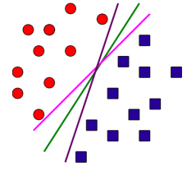
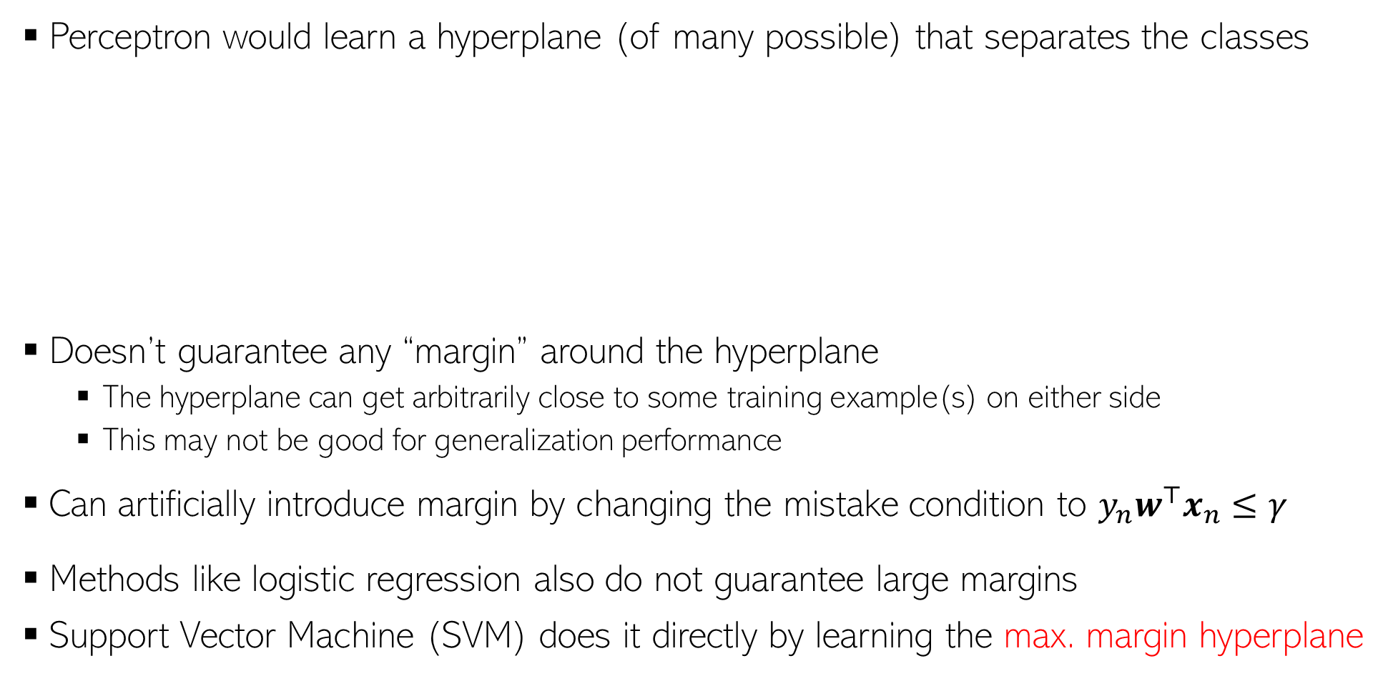

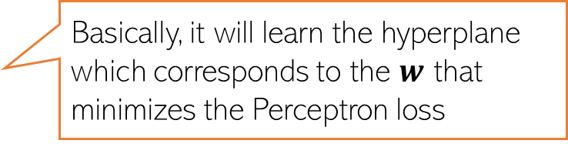
Perceptron and (lack of) Margins
Perceptron would learn a hyperplane (of many possible) that separates the classes
Doesn’t guarantee any “margin” around the hyperplane
The hyperplane can get arbitrarily close to some training example(s) on either side
This may not be good for generalization performance
Can artificially introduce margin by changing the mistake condition to $y_{n}w^{⊤}x_{n}≤γ$
Methods like logistic regression also do not guarantee large margins
Support Vector Machine (SVM) does it directly by learning the max. margin hyperplane
Basically, it will learn the hyperplane which corresponds to the $w$ that minimizes the Perceptron loss
Kind of an “unsafe” situation to have – ideally would like it to be reasonably away from closest training examples from either class
$γ>0$ is some pre-specified margin

Slide 8
Learning Large-Margin Hyperplanes

Slide 9

Support Vector Machine (SVM)
SVM originally proposed by Vapnik and colleagues in early 90s
Hyperplane based classifier. Ensures a large margin around the hyperplane
Will assume a linear hyperplane to be of the form $w^{⊤}x+b=0$ (nonlinear ext. later)
Two other “supporting” hyperplanes defining a “no man’s land”
Ensure that zero training examples fall in this region (will relax later)
The SVM idea: Position the hyperplane s.t. this region is as “wide” as possible
$$w^{⊤}x+b=1$$
$$w^{⊤}x_{n}+b≥1 if y_{n}=+1$$
Class +1
$$w^{⊤}x+b=−1$$
$$w^{⊤}x_{n}+b≤−1 if y_{n}=−1$$
$$w^{⊤}x+b≥1$$
Distance from the closest point (on either side)
$${y_{n}(w}^{⊤}x_{n}+b)≥1 ∀n$$
Distance of an input $x_{n}$ from the h.p.
“Margin” of the hyperplane
Class -1
$$γ=\min_{1≤n≤N}\frac{\left|w^{⊤}x_{n}+b\right|}{\left\|w\right\|}$$
$$= \frac{1}{\left\|w\right\|}$$
$$w^{⊤}x+b≤−1$$
Want the hyperplane $(w,b)$ such that this margin is maximized (max-margin hyperplane) and
$${y_{n}(w}^{⊤}x_{n}+b)≥1 ∀n$$
$$w^{⊤}x+b=0$$
$$Total margin=\frac{2}{\left\|w\right\|}$$
Constrained optimization problem
The 1/-1 in supp. h.p. equations is arbitrary; can replace by any scalar m/-m and solution won’t change, except a simple scaling of $w$

Slide 10
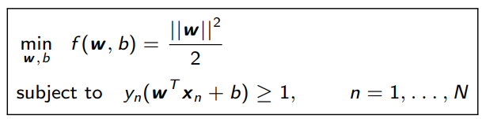
Hard-Margin SVM
Hard-Margin: Every training example must fulfil margin condition ${y_{n}(w}^{⊤}x_{n}+b)≥1$
Meaning: Must not have any example in the no-man’s land
$$w^{⊤}x+b=1$$
Also want to maximize margin $2γ= \frac{2}{\left\|w\right\|}$
Equivalent to minimizing ${\left\|w\right\|}^{2}$ or $\frac{{\left\|w\right\|}^{2}}{2}$
The objective func. for hard-margin SVM
Class +1
$$w^{⊤}x+b≥1$$
$$w^{⊤}x+b=−1$$
Class -1
$$w^{⊤}x+b≤−1$$
$$w^{⊤}x+b=0$$
Constrained optimization problem with $N$ inequality constraints. Objective and constraints both are convex
Lagrange based optimization can be used to solve it

Slide 11
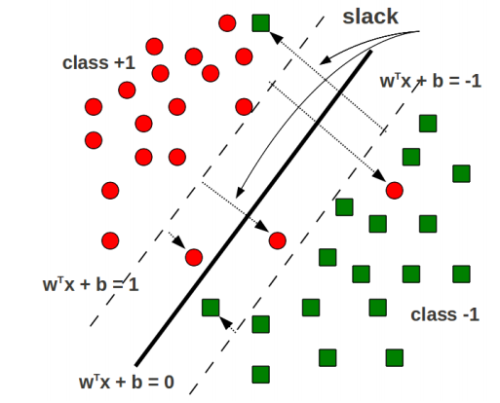
Soft-Margin SVM (More Commonly Used)
Allow some training examples to fall within the no-man’s land (margin region)
Even okay for some training examples to fall totally on the wrong side of h.p.
Extent of “violation” by a training input ($x_{n},y_{n}$) is known as slack $ξ_{n}≥0$
$ξ_{n}>1$ means totally on the wrong side
Helps in getting a wider margin (and better generalization)
Note/verify that the slack for each training example is just the hinge loss
$$w^{⊤}x_{n}+b≥1 −ξ_{n} if y_{n}=+1$$
$$w^{⊤}x_{n}+b≤−1+ξ_{n} if y_{n}=−1$$
$$ξ_{n}= max\{0,1−{y_{n}(w}^{⊤}x_{n}+b)\}$$
$${y_{n}(w}^{⊤}x_{n}+b)≥1 −ξ_{n} ∀n$$
Soft-margin constraint

Slide 12
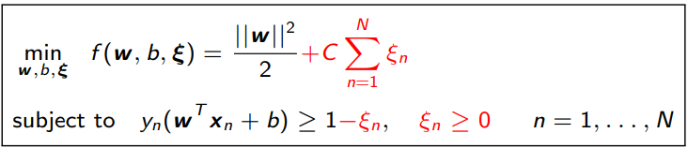

Soft-Margin SVM (Contd)
Sum of slacks is like the training error
Goal: Still want to maximize the margin such that
Soft-margin constraints ${y_{n}(w}^{⊤}x_{n}+b)≥1 −ξ_{n}$are satisfied for all training ex.
Do not have too many margin violations (sum of slacks $\sum_{n=1}^{N}{ξ_{n}}$ should be small)
Lagrange based optimization can be used to solve it
The objective func. for soft-margin SVM
Hyperparameter $C$ controls the trade off between large margin and small training error (need to tune)
Too large $C$: small training error but also small margin (bad)
Too small $C$: large margin but large training error (bad)
Inversely prop. to margin
Trade-off hyperparam
training error
Constrained optimization problem with $2N$ inequality constraints. Objective and constraints both are convex

Slide 13
Solving the SVM Problem

Slide 14
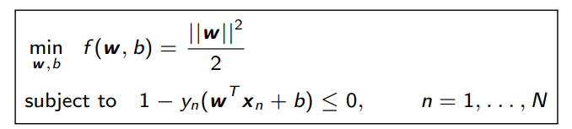
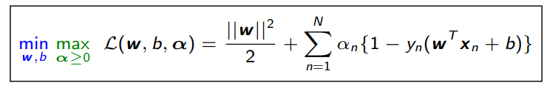
Solving Hard-Margin SVM
The hard-margin SVM optimization problem is
A constrained optimization problem. One option is to solve using Lagrange’s method
Introduce Lagrange multipliers $α_{n} (n=1,…, N)$, one for each constraint, and solve
$α=[α_{1},α_{2},…,α_{N}]$ denotes the vector of Lagrange multipliers
It is easier (and helpful; we will soon see why) to solve the dual: min and then max

Slide 15
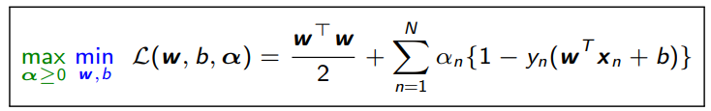
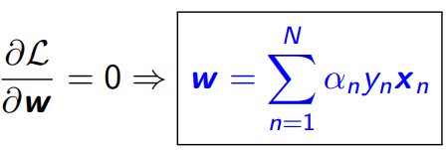
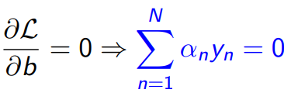
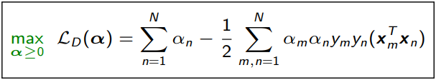

Solving Hard-Margin SVM
Note: if we ignore the bias term $b$ then we don’t need to handle the constraint $\sum_{n=1}^{N}{α_{n}y_{n}=0}$ (problem becomes a bit more easy to solve)
The dual problem (min then max) is
Take (partial) derivatives of $ℒ$ w.r.t. $w$ and $b$ and setting them to zero gives (verify)
The solution $w$ is simply a weighted sum of all the training inputs
Substituting $w= \sum_{n=1}^{N}{α_{n}y_{n}x_{n}}$ in the Lagrangian, we get the dual problem as (verify)
Otherwise, the $α_{n}$’s are coupled and some opt. techniques such as co-ordinate ascent can’t easily be applied
$α_{n}$tells us how important training example ($x_{n},y_{n}$) is
This is also a “quadratic program” (QP) – a quadratic function of the variables $α$
IMPORTANT: inputs appear only as pairwise dot products. This will be useful later on when we make SVM nonlinear using kernel methods
Maximizing a concave function (or minimizing a convex function) s.t. $α≥0$ and $\sum_{n=1}^{N}{α_{n}y_{n}=0}$. Many methods to solve it.
G is an $N× N$p.s.d. matrix, also called the Gram Matrix, $G_{nm}=y_{n}y_{m}{x_{n}}^{⊤}x_{m},$ and 1 is a vector of all 1s
(Note: For various SVM solvers, can see “Support Vector Machine Solvers” by Bottou and Lin)

Slide 16
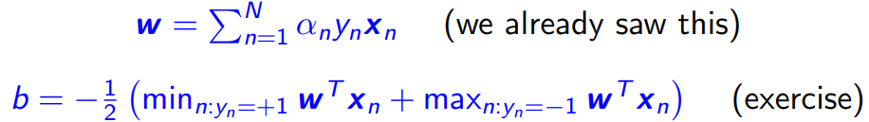
Solving Hard-Margin SVM
One we have the $α_{n}$’s by solving the dual, we can get $w$ and $b$ as
A nice property: Most $α_{n}$’s in the solution will be zero (sparse solution)
$$w^{⊤}x+b=1$$
Reason: KKT conditions
For the optimal $α_{n}$’s, we must have
Thus $α_{n}$ nonzero only if $y_{n}\left(w^{⊤}x_{n}+b\right)=1$, i.e., the training example lies on the boundary
These examples are called support vectors
$$w^{⊤}x+b=−1$$
$$α_{n}\left\{1−y_{n}\left(w^{⊤}x_{n}+b\right)\right\}=0$$
$$w^{⊤}x+b=0$$

Slide 17
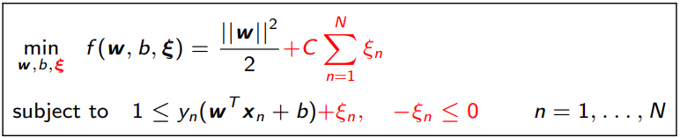
Solving Soft-Margin SVM
Recall the soft-margin SVM optimization problem
Here $ξ=\left[ξ_{1},ξ_{2},…, ξ_{N}\right]$ is the vector of slack variables
Introduce Lagrange multipliers $α_{n},β_{n}$ for each constraint and solve Lagrangian
The terms in red color above were not present in the hard-margin SVM
Two set of dual variables $α=[α_{1},α_{2},…,α_{N}]$ and $β=[β_{1},β_{2},…,β_{N}]$
Will eliminate the primal var $w$, b, $ξ$ to get dual problem containing the dual variables

Slide 18
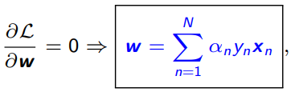


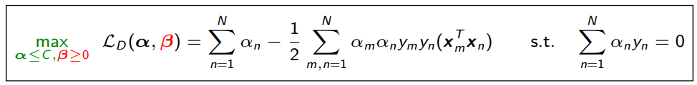

Solving Soft-Margin SVM
Note: if we ignore the bias term $b$ then we don’t need to handle the constraint $\sum_{n=1}^{N}{α_{n}y_{n}=0}$ (problem becomes a bit more easy to solve)
The Lagrangian problem to solve
Take (partial) derivatives of $ℒ$ w.r.t. $w,b$, and $ξ_{n}$ and setting to zero gives
Using $C−α_{n}−β_{n}=0$ and $β_{n}≥0$, we have $α_{n}≤C$(for hard-margin, $α_{n}≥0)$
Substituting these in the Lagrangian $ℒ$ gives the Dual problem
Otherwise, the $α_{n}$’s are coupled and some opt. techniques such as co-ordinate aspect can’t easily applied
Weighted sum of training inputs
The dual variables $β$ don’t appear in the dual problem!
Given $α$, $w$ and $b$ can be found just like the hard-margin SVM case
Maximizing a concave function (or minimizing a convex function) s.t. $α≤C$ and $\sum_{n=1}^{N}{α_{n}y_{n}=0}$. Many methods to solve it.
In the solution, $α$ will still be sparse just like the hard-margin SVM case. Nonzero $α_{n}$ correspond to the support vectors
(Note: For various SVM solvers, can see “Support Vector Machine Solvers” by Bottou and Lin)

Slide 19
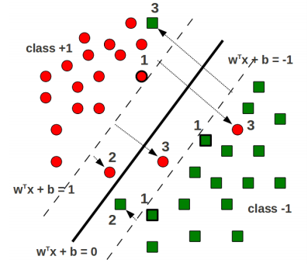
Support Vectors in Soft-Margin SVM
The hard-margin SVM solution had only one type of support vectors
All lied on the supporting hyperplanes $w^{⊤}x_{n}+b=1$ and $w^{⊤}x_{n}+b=−1$
The soft-margin SVM solution has three types of support vectors (with nonzero $α_{n}$)
Lying on the supporting hyperplanes
Lying within the margin region but still on the correct side of the hyperplane
Lying on the wrong side of the hyperplane (misclassified training examples)

Slide 20
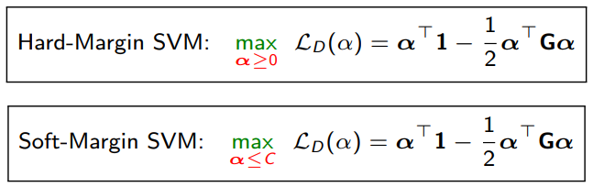
SVMs via Dual Formulation: Some Comments
Recall the final dual objectives for hard-margin and soft-margin SVM
The dual formulation is nice due to two primary reasons
Allows conveniently handling the margin based constraint (via Lagrangians)
Allows learning nonlinear separators by replacing inner products in $G_{nm}=y_{n}y_{m}{x_{n}}^{⊤}x_{m}$ by general kernel-based similarities (more on this when we talk about kernels)
However, dual formulation can be expensive if $N$ is large (esp. compared to $D$)
Need to solve for $N$ variables $α=[α_{1},α_{2}, …,α_{N}]$
Need to pre-compute and store $N× N$gram matrix G
Lot of work on speeding up SVM in these settings (e.g., can use co-ord. descent for $α$)
Note: Both these ignore the bias term $b$ otherwise will need another constraint $\sum_{n=1}^{N}{α_{n}y_{n}=0}$

Slide 21
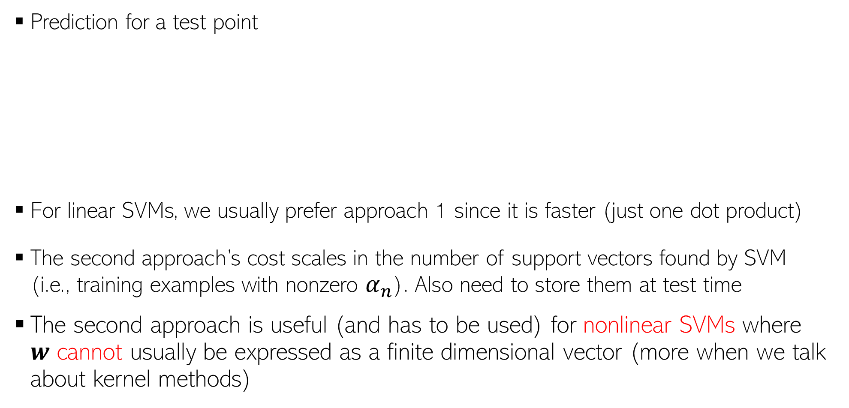
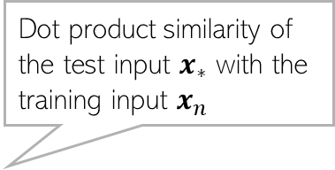
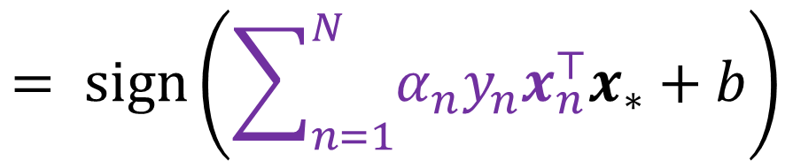

SVM: At Test Time
Prediction for a test point
For linear SVMs, we usually prefer approach 1 since it is faster (just one dot product)
The second approach’s cost scales in the number of support vectors found by SVM (i.e., training examples with nonzero $α_{n}$). Also need to store them at test time
The second approach is useful (and has to be used) for nonlinear SVMs where $w$ cannot usually be expressed as a finite dimensional vector (more when we talk about kernel methods)
$$y_{∗}=sign(w^{⊤}x_{∗}+b)$$
Dot product similarity of the test input $x_{∗}$ with the training input $x_{n}$
(Approach 1)
$$= sign\left(\sum_{n=1}^{N}{α_{n}y_{n}x_{n}^{⊤}x_{∗}}+b\right)$$
(Approach 2)

Slide 22
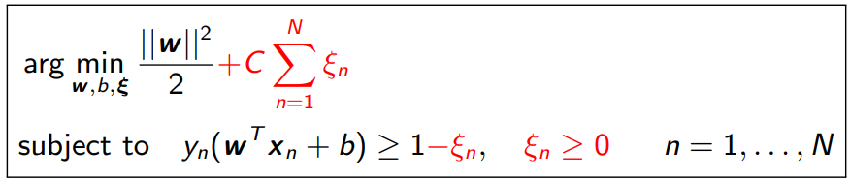
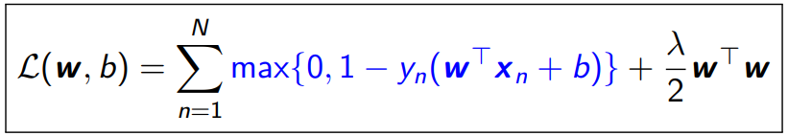
Solving for SVM in the Primal
Maximizing margin subject to constraints led to the soft-margin formulation of SVM
Note that slack $ξ_{n}$ is the same as $max\{0,1−y_{n}\left(w^{⊤}x_{n}+b\right)\}$, i.e., hinge loss for ($x_{n},y_{n}$)
Thus the above is equivalent to minimizing the $ℓ_{2}$ regularized hinge loss
Sum of slacks is like sum of hinge losses, $C$ and $λ$ play similar roles
Can learn $(w, b)$directly by minimizing $ℒ(w, b)$using (stochastic)(sub)grad. descent
Hinge-loss version preferred for linear SVMs, or with other regularizers on $w$ (e.g., $ℓ_{1})$

Slide 23
A Co-ordinate Ascent Algorithm for SVM
Recall the dual objective of soft-margin SVM (assuming no bias $b$)
Focusing on just one of the components of $α$ (say $α_{n}$), the objective becomes
The above is a simple quadratic maximization of a concave function: Global maxima
If constraint violated, project $α_{n}$ in $[0,C]$: If $α_{n}<0$, set it to 0, if $α_{n}>C$, set it to $C$
Can cycle through each coordinate $α_{n}$ in a random or cyclic fashion
$$\underset{0≤α≤C}{argmax} \sum_{n=1}^{N}{α_{n}} − \frac{1}{2}\sum_{m,n=1}^{N}{α_{m}α_{n}y_{m}y_{n}x_{m}^{⊤}}x_{n}$$
Note that $w= \sum_{n=1}^{N}{α_{n}y_{n}x_{n}}$
Can efficiently compute it if we also store $w$. It is equal to $w^{⊤}x_{n}−α_{n}y_{n}$ ${\left\|x_{n}\right\|}^{2}$
Can compute these in the beginning itself
$\underset{0≤α_{n}≤C}{argmax} α_{n}−\frac{1}{2}α_{n}^{2 }{\left\|x_{n}\right\|}^{2} −\frac{1}{2}α_{n}y_{n}\sum_{m≠n}{α_{m}y_{m}x_{m}^{⊤}}$ $x_{n}$

Slide 24
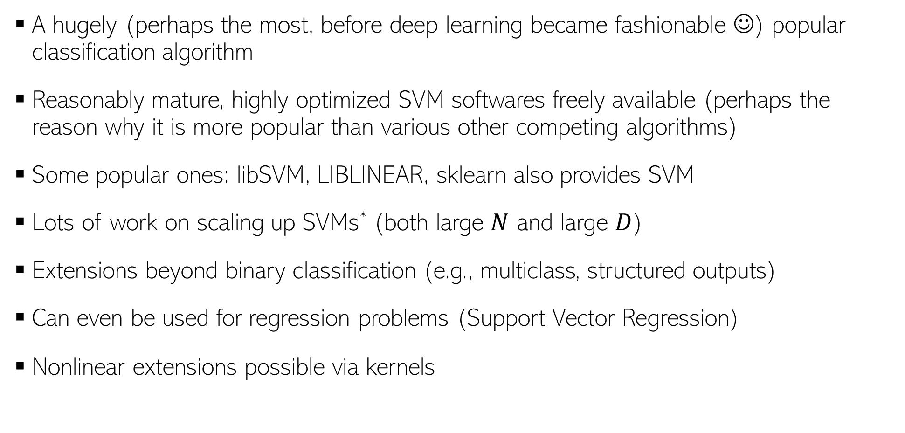
SVM: Summary
A hugely (perhaps the most, before deep learning became fashionable ☺) popular classification algorithm
Reasonably mature, highly optimized SVM softwares freely available (perhaps the reason why it is more popular than various other competing algorithms)
Some popular ones: libSVM, LIBLINEAR, sklearn also provides SVM
Lots of work on scaling up SVMs* (both large $N$ and large $D$)
Extensions beyond binary classification (e.g., multiclass, structured outputs)
Can even be used for regression problems (Support Vector Regression)
Nonlinear extensions possible via kernels
* See: “Support Vector Machine Solvers” by Bottou and Lin

